Slide 1
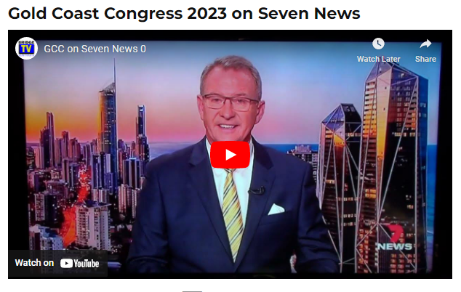
How to WRITE a
MEDIA Release
February 2023
Peter J. Cox – Head of ABF Marketing

Slide 2
The Potential of Media
To buy Media Time is highly expensive and uneconomic for a sport like Bridge with a relatively low number of players and no fan base.
However, it is possible to obtain publicity for free in local newspapers, television and radio.
In regional and country areas in particular the local media want to be part of the community to attract local engagement and advertising.
You can create content for the district newspaper, radio station and television station for free by issuing a Media Release.
First determine the purpose for your Media Release and what are you trying to achieve – bring players back to the club, new players, beginners classes, local congress, 100th birthday party, bridge players other sporting success or community achievement.
Then identify your target audience: Who do you want to reach with your release? Young university people or retirees and seniors? Knowing your target audience will help you tailor the language and tone of your release.
Here is a guide to preparing a Media Release.

Slide 3
MEDIA RELEASE TEMPLATE
Writing the Media Release is not difficult but you need to follow the format that the industry uses and provides the journalist with concisely the information they require.
HEADLINE
LEAD
BODY
END
CONTACT
BOILER PLATE
All on One Page

Slide 4
Catch Attention
HEADLINE
The headline of a media release should summarise the key points, but be catchy, interesting and strong. It is designed to catch attention and encourage further reading. Ensure you bold it.
A couple of my headings:
Youngest person at age 9 to play in a major Open Australian Bridge Championship
Australian female Olympic shooter wins 2020 International Bridge Press Association Book of the Year Award.
LEAD
The lead paragraph is the key part of your media release. It is essential that your lead is punchy and has the story hook. Check that it includes: who, what, when, where, why and how.
Example of opening line.:
A particular feature this year is believed to be the youngest person, Taydon Gold age 9, to have ever competed in a major Bridge event in Australia.
Kim Frazer, an Olympian in Athens 2004 and winner of three gold medals in four Commonwealth games for shooting, has won a prestigious international award for writing a book “Gaining the Mental Edge at Bridge.”

Slide 5
Story Time
BODY
The paragraph under the lead should expand on the lead and be the point where you start telling the story. It is important to prioritise messages from the most important to the least important. Use short sentences and short paragraphs with vigorous, active language. Always write in the third person.
Use quotes to make your writing more interesting but remember all opinions must be attributed to a particular person or the organisation. The media is unable to use newsworthy assertions unless sourced, and journalists will sometimes call to check on the quotes.
Example
The President of the Victorian Bridge Association, Ben Thompson, said that "Bridge is a fantastic and intellectual game suitable for everyone from 10-100. I am really pleased to see 9 year old Taydon Gold taking to bridge like a fish to water."
The President of the ABF, Allison Stralow, says “It is a great honour for Australian bridge that Kim has won such a prestigious award against international competition.”

Slide 6
Closing
END
The last paragraph is the least important and can include background information about you and your services or summarise the essential elements of the media release.
Always finish the media release with -ends- so the journalist knows it is finished.
CONTACT
Make sure you include the following contact information.
  For further media information contact:
  Contact name
  Email
  Phone number
BOILER PLATE (ABOUT YOU AND YOUR BUSINESS)
It is important to include a boiler plate at the bottom of your media release. A boiler plate is a one paragraph summary of background information about yourself and your business. This information will give the journalist an overview and isn’t necessarily needed in the body of the media release.

Slide 7
Media Release Distribution
There are Press Release Distributors like MediaNet and Get The Word Out particularly for National, Capital City or Regional distribution but they are very expensive and have limited success.
It is better to make a short list of the TV, Radio and Newspaper publishers in your target market. They will often have a contact email address on their web site and if not ring and ask them where to send a Media Release.
Make sure that you completed the contact information and that you are available to answer the phone or email immediately at any hour.
In smaller markets staff may live in your community and be known to bridge players and be a source of introduction.

Slide 8
THE MEDIA RELEASE

Slide 9
THE STORY - The Age Page 3 Carolyn Webb 10 June 2018

Slide 10
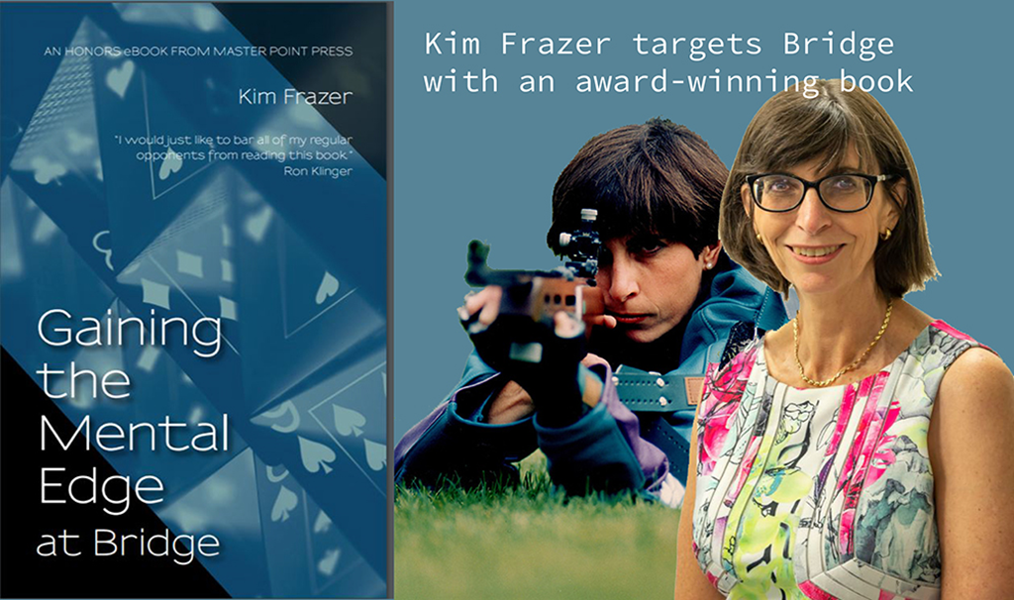
THE MEDIA RELEASE

Slide 11
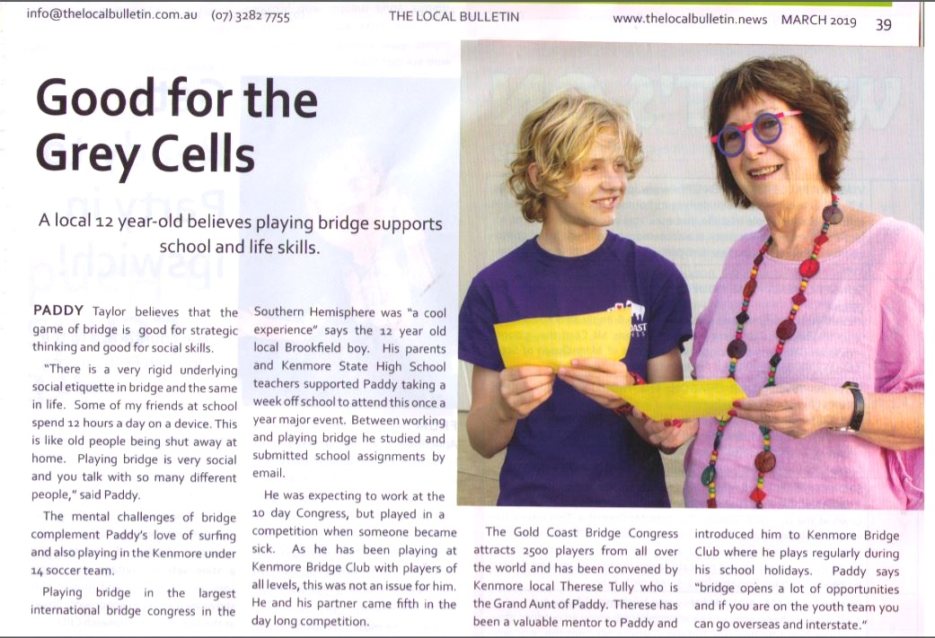
Local Paper in Brisbane

Slide 12
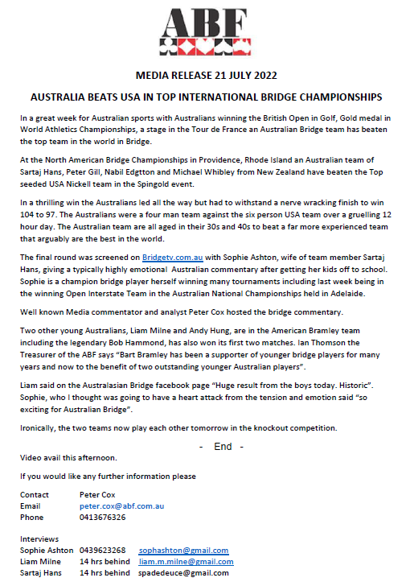
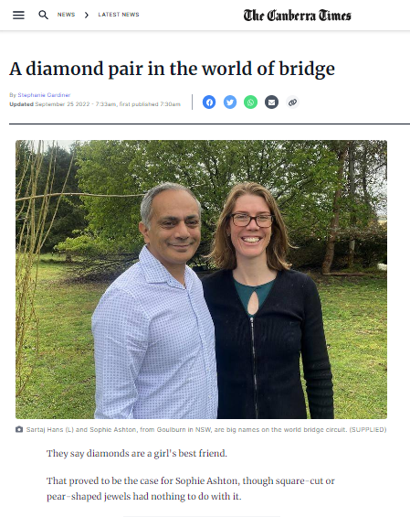
You don’t control the narrative
You can influence the content but the Journalist controls the story.
The Press Release was about Australians doing well in an International event but the journalist ran with a love story about bridge players in the local community. A lovely story and promotes bridge.

Slide 13
Press Release
Wednesday 22 February 2023
President of the World Bridge Federation visits Australia
Jan Kamras, the President of the World Bridge Federation is in Broadbeach for Australia’s largest bridge competitions the Gold Coast Congress and one of the bridge world’s most prestigious tournaments.
The WBF President is visiting Australia to promote the announcement of a World Bridge Tour that will feature leading world players similar to Tennis and other top sports.
Played at the Broadbeach Convention Centre with over 2000 players for 9 days it features not only Australia’s best players but some international bridge Superstars.
Players have travelled from Europe, Finland, England, the USA, Malaysia, Argentina, Austria, Canada, Croatia, France, Germany, Ireland, Netherlands, Sri Lanka, Sweden, UK, Uruguay, US plus 190 players from New Zealand.
The WBF President opened the Gold Coast Congress which is the first event in the new World Bridge Tour. The WBF is recognised by the International Olympic Committee.
The President of the Australian Bridge Federation, Allison Stralow, said “We welcome all players from near and far whether this is their first time or they have been coming for years. Bridge has a real sense of community and enjoyment as well as competition and when travelling you are part of the bridge family all around Australia and the world.
International players included Finn Kolesnik aged 18, who playing with Australian Ishmael Delmonte won one of America’s top events the NABC Soloway Teams in Phoenix Arizona recently. Another of his team mates was Kevin Rosenberg who is in Broadbeach, who is Junior and Open World Champion, playing with Amber Lin
Jan Kamras from Sweden, the WBF President, is also playing in the Gold Coast Congress with an Australian Martin Doran and team mates champion Barbara Travis from Adelaide and Peter Reynolds from Canberra.
Other International players include 6 time World Champion Kate McCallum who is now living in Adelaide, three time world champion Daniele Von Arnim from Germany, and Austrian Jovi Smederevac.
The major Teams event is from Tuesday 21 to Thursday 23 February at the Gold Coast Convention Centre from 10am to 6pm.
END -
If you would like any further information please
CONTACT: Peter Cox 0413 676 326 or petercox@ozemail.com.au
The Australian Bridge Federation is the peak body for the administration of Bridge in Australia and is an affiliate of the World Bridge Federation. It is a non-profit organisation and its headquarters are located in Canberra. The ABF has a membership of approximately 33,000 and there are nearly 350 affiliated bridge clubs throughout Australia.

Slide 14
Media Coverage from GCC Press Release
You must be available to take media calls at ALL times after Media Release
Select the right people to be interviewed who speak confidently with full knowledge and most importantly passion
Guide the interviewee on the most important you want conveyed if possible
The media do not want to interview the marketing person (the ABC refuses to)
Listen to what the reporter wants to do and fully assist them
THE RESULTS
Radio interview on Radio 6PR Perth - Allison Stralow, ABF President
Radio interview on ABC Radio Melbourne - Ben Thompson, WBF Vice President
TV story filmed at the Convention Centre on Seven News Gold Coast – 1 min 40 sec

Slide 15
- END-
My final piece of advice is that the Media Release is not about YOU.
You are writing about the person or the event not about yourself.
Think about a Headline that will capture the Journalist or Editors attention.
Get the information over clearly but precisely. They see a lot of Media releases in a day and why should they read yours let alone take action.
Quotes are essential but not your quotes.
Pictures are worth a thousand words.
Don’t forget Contact details or all the work is wasted.
Try and fit it on ONE PAGE.
If you would like help send me your draft Media Release and I will read it and make suggestions at marketing@abf.com.au

